Slide 1


Project 1: MVC Shop
Tiger King Pet Shop
By: Ken Endo

Slide 2








Tools
Entity Framework Core
Visual Studio
ASP.NET MVC
Microsoft SQL Server
Visual Studio
Bootstrap

Slide 3
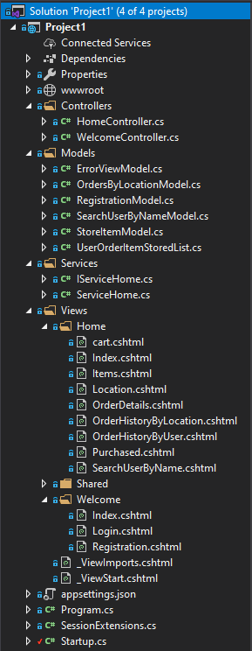

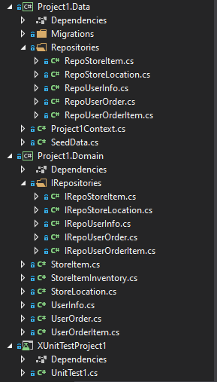
Project Design/Structure
Project Domain
EF Core Code First Properties/3NF
IRepositories
Project Data
DB Context
Migration
Seed Data (Populate Location & Items)
Repositories
MVC
Controllers/Models/Views – Strongly Typed/minimum logic
Service – Business Logic
Loosely coupled
Separation of concern

Slide 4




Functionalities & Implementation
Client/Server Validation
Exception Handling
CSRF
Logging
Documentation
XML Comments
Dependency Injection
xUnit Test

Slide 5

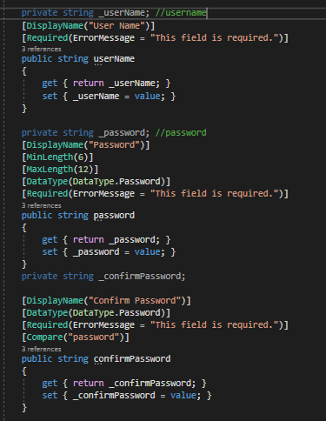

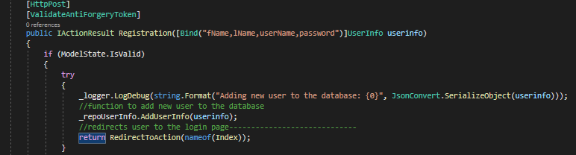
Client Validation
Data Annotations
Input validation
Server Validation
ModelState
ValidateAntiForgeryToken [Form]

Slide 6
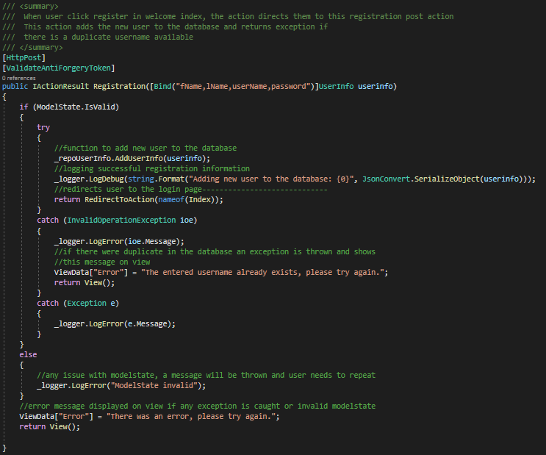
Exception Handling
Try – Catch block
Logging
Log errors and events
Documentations
Inline comments
XML comments

Slide 7
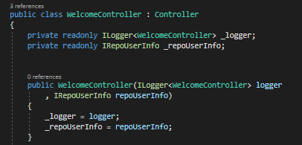
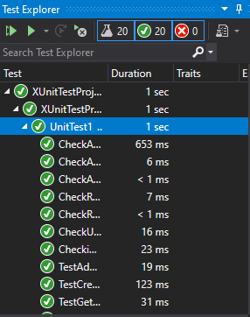
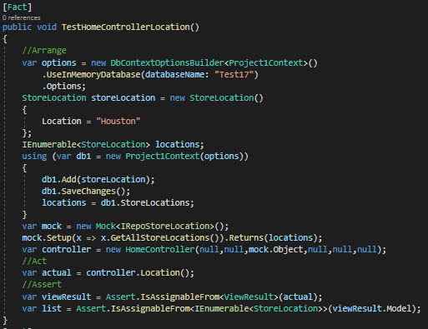
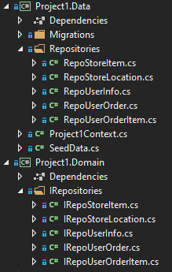
Dependency Injection
Ilogger
IRepositories
Iservice
Loosely coupled
xUnit Test
20 Tests
Moq Test

Slide 8


Demo

